Slide 1
Medilink Github Repository Guided by: Professor Chernak Yuri
Team 1
Project Manager : Omkar Jaliparthi
Product Owner : Anirudh Padma
Business Analyst : Dhanunjaya Sannapaneni
Lead Developer : Rajbasheer Baig Mogal
Developer : Yinning Chen
Database Developer : Sarjakkumar Kothiya
QA Analyst : Murali Marupudi
Software Tester : Dinesh Gangavaram
Software Tester : Mohan Sai Ravilla
Software Tester : Gowtami Singamsetty

Slide 2

GitHub Repo Link
🔗 https://github.com/sarjakkk/Medilink

Slide 3



GitHub Repo Structure
Maven
src
Jenkins.txt
Pom.xml
MySqlCommand.txt
Intructions.txt
Final Presentation

Slide 4
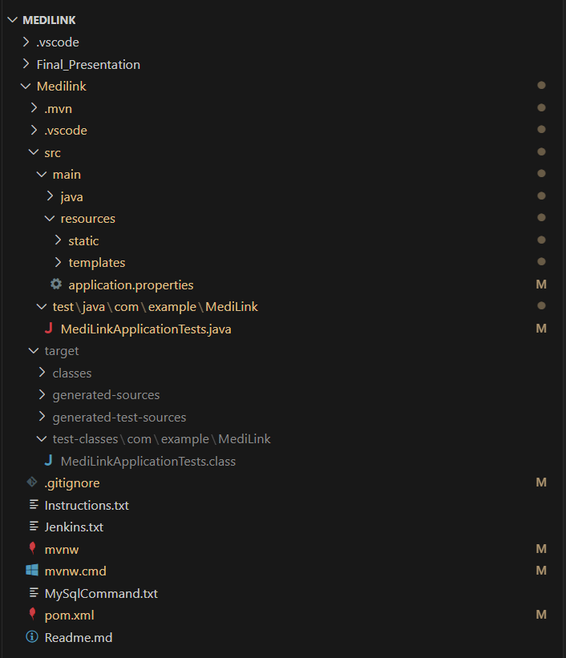
GitHub Source Code Structure

Slide 5
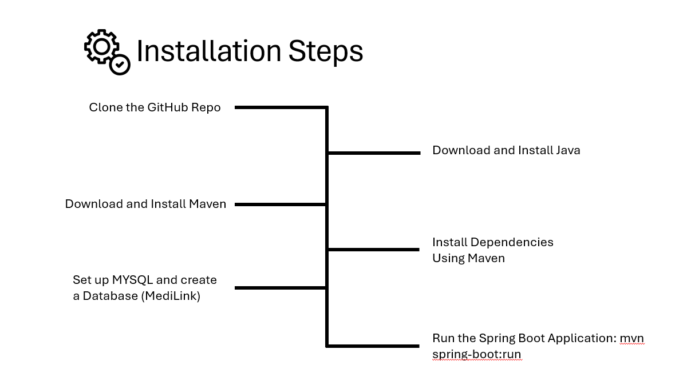

Slide 6
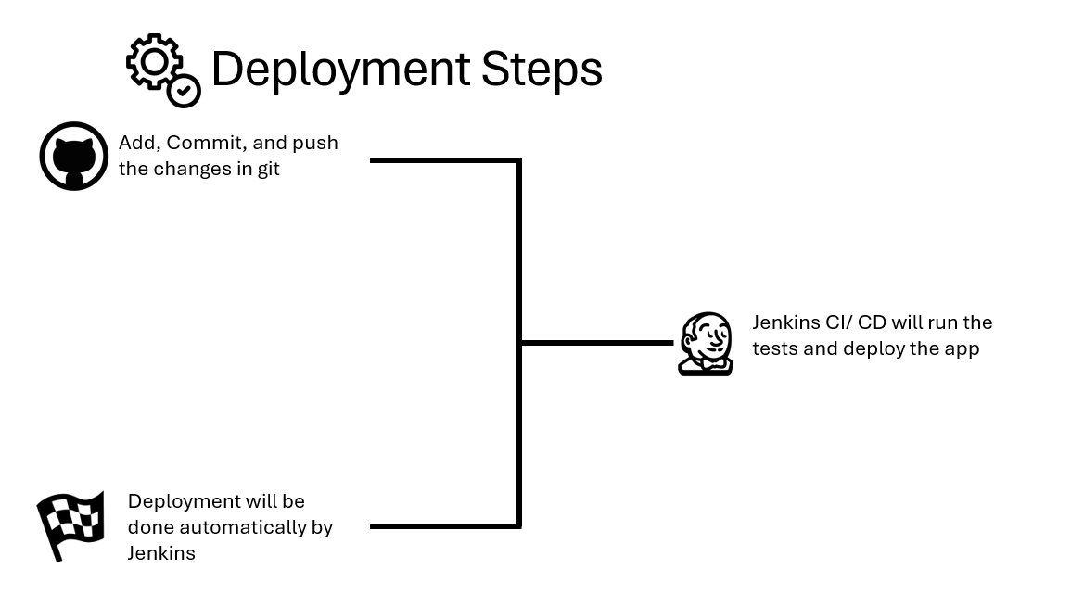

Slide 7
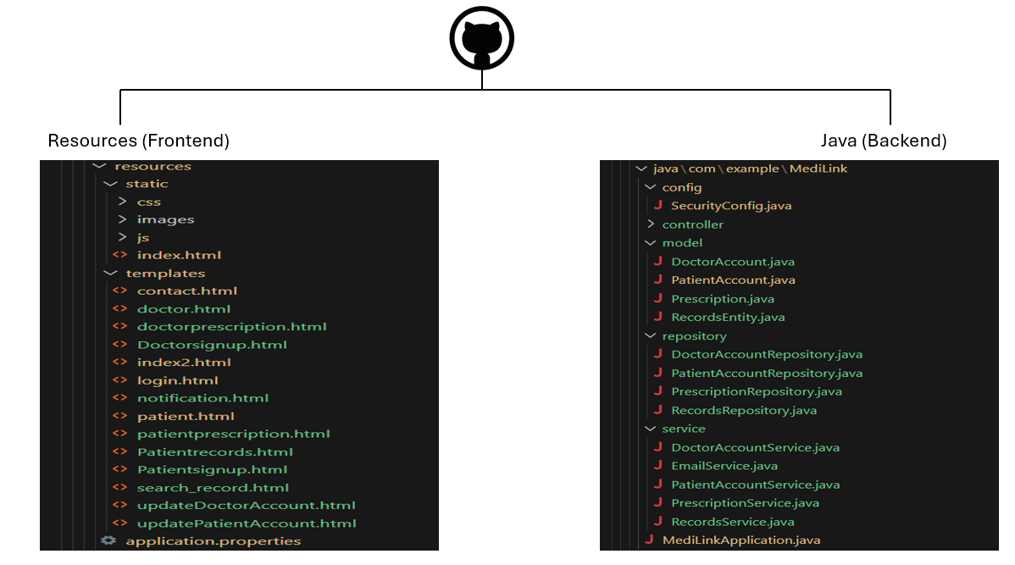
Frontend and backend structure

Slide 8
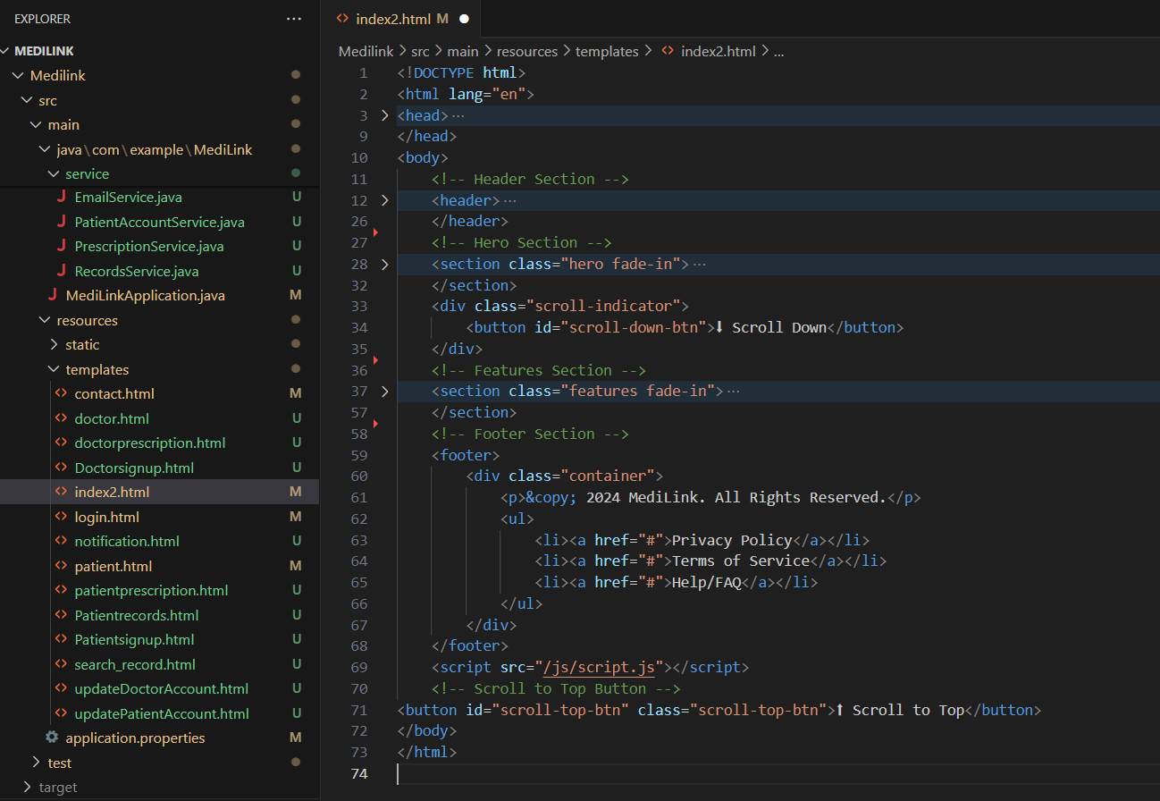
Resources (Home-page: index.html)

Slide 9
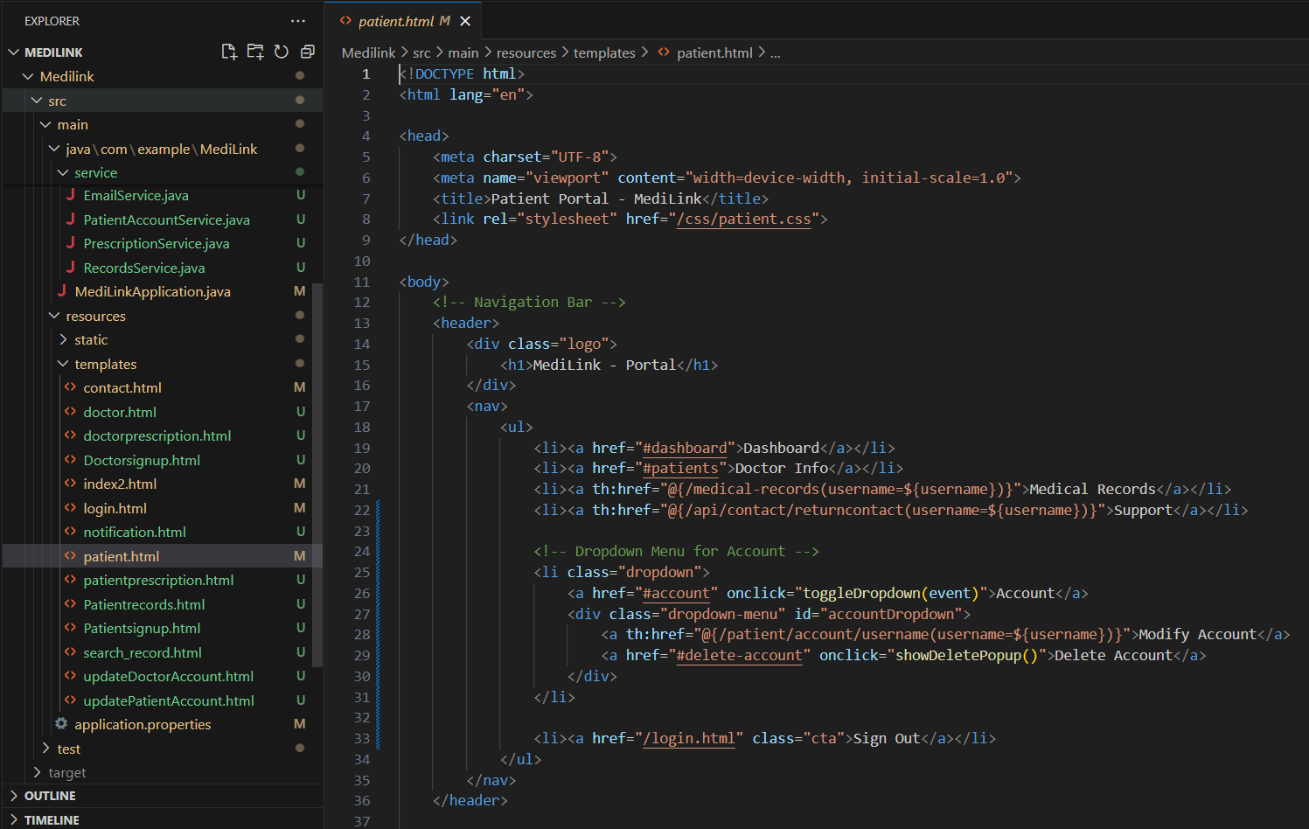
Patient Portal : Patient.html

Slide 10
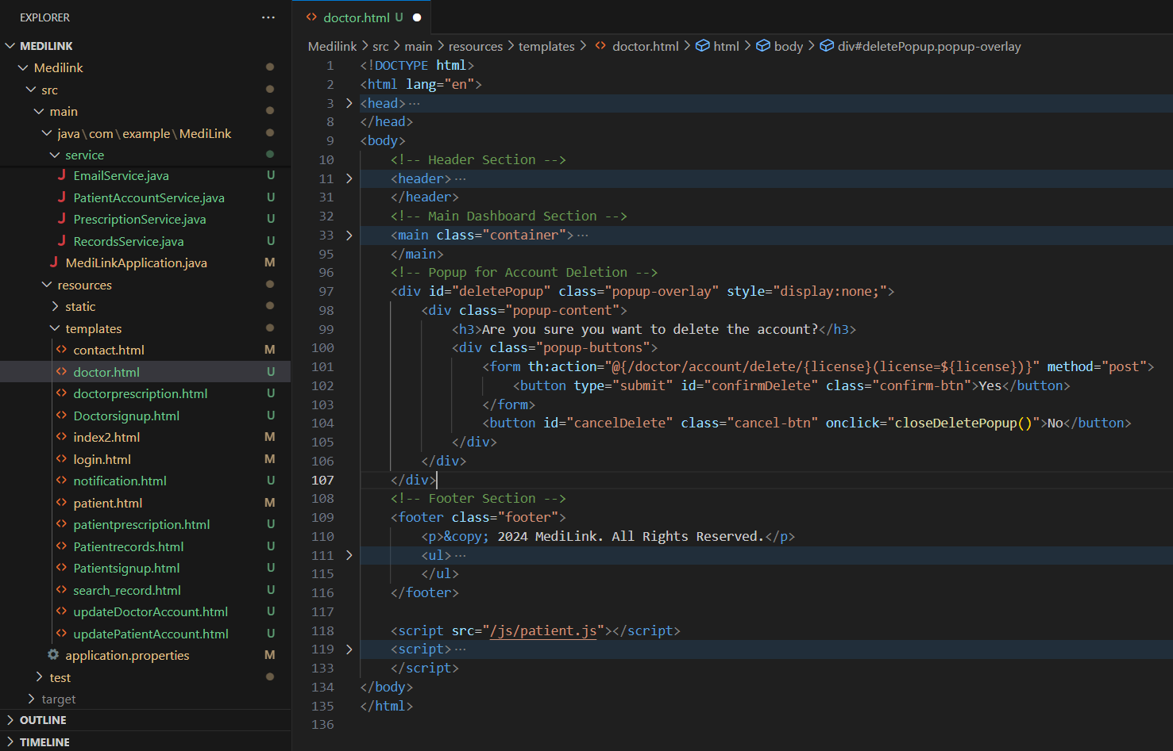
Patient Portal : Doctor.html

Slide 11
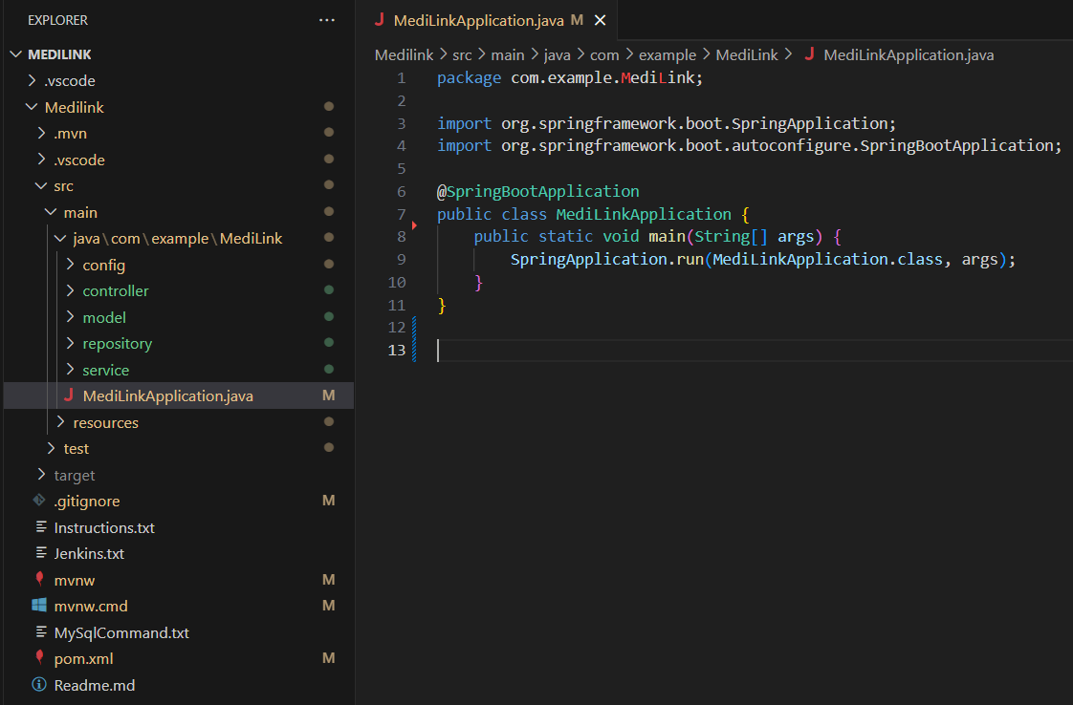
Java (Spring Boot)

Slide 12
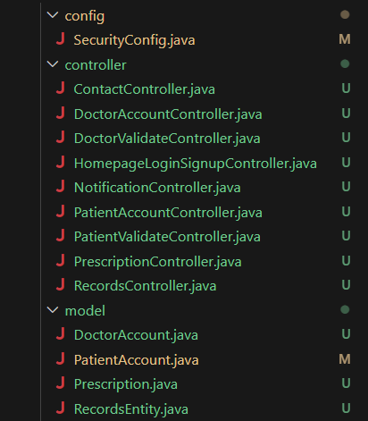
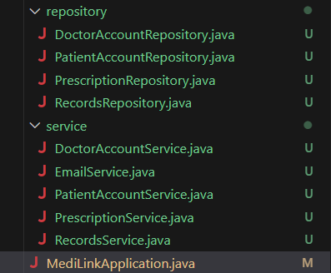
Back end (Spring Boot) Packages

Slide 13
Thank You

